Slide 1





Bank Management System / ATM

Slide 2
University OOP Project
Submitted To: Miss Atika Islam
Submitted By: Abdul Rahman
(54633)

Slide 3
Introduction:
The “Bank Account Management System” project is a model Internet Banking Site. This site enables the customers to perform the basic banking transactions by sitting at their office or at homes through PC or laptop. The system provides the access to the customer to create an account, deposit/withdraw the cash from his account, also to view reports of all accounts present.

Slide 4
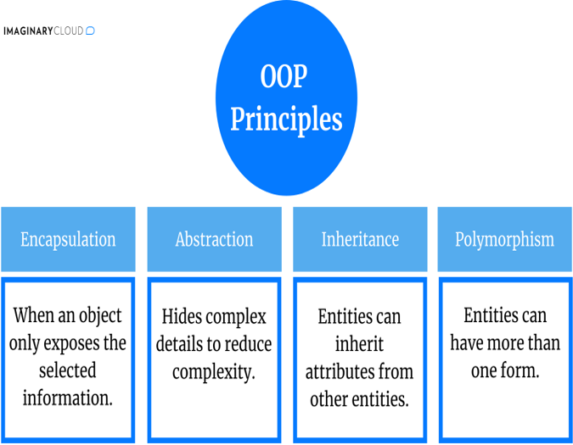
Features and OOP Principles
Add/delete/update account
Withdrawal/deposit/statements transaction
Data Base Implementation
View transaction histories
User login, use PIN system
Creating/open new account registration
View statements transaction
User account details
Change Password and Pin
Input Validation

Slide 5
Objectives
of the project

Slide 6
Objectives
Our aim
The goal
The main aim of designing and developing this Internet banking System Java primarily based Engineering project is to provide secure and efficient net banking facilities to the banking customers over the internet. MYSQL database used to develop this bank application where all banking customers can login through the secured web page by their account login id and password. Users will have all options and features in that application like get money, money transfer , and send cash .
Client doesn't need to go to the bank to do small operation.
Help client transferring money to/or another bank or country.
It helps the customer to be satisfied and comfortable in his choices, this protection contains customer’s account, money and his privacy.

Slide 7
Thanks

